Slide 1
DISTANCE MEASUREMENT USING HC SR04
Measures distance without physical contact
Uses ultrasonic sound waves for detection
Fast and accurate measurement
Works with Arduino for real-time results
Used in automation and safety systems.

Slide 2
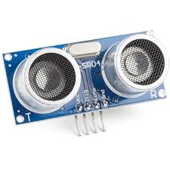
What is HC-SR04?
Ultrasonic distance measuring sensor
Measures objects from 2 cm to 400 cm
Uses sound waves instead of light
Low cost and easy to interface with Arduino
Common in robotics and obstacle detection

Slide 3
The sensor sends out an ultrasonic sound pulse, which hits an object and returns back. By measuring how long it takes to return, distance is calculated.
Sensor emits a 40 kHz ultrasonic wave
Wave reflects from object surface
Echo signal return time is measured
Distance calculated using:
Distance=Time×Speed of Sound

Slide 4
ARCHITECTURAL INTRODUCTION TO HS SR04
Has 4 pins,
HC-SR04 has 4 pins:
VCC – Power supply (5V from Arduino)
Trig – Sends ultrasonic pulse
Echo – Receives reflected pulse
GND – Ground connection
Behavior
Arduino sets Trig HIGH for 10µs
Sensor sends ultrasonic burst
Echo pin becomes HIGH until wave returns
Arduino measures Echo HIGH duration

Slide 5
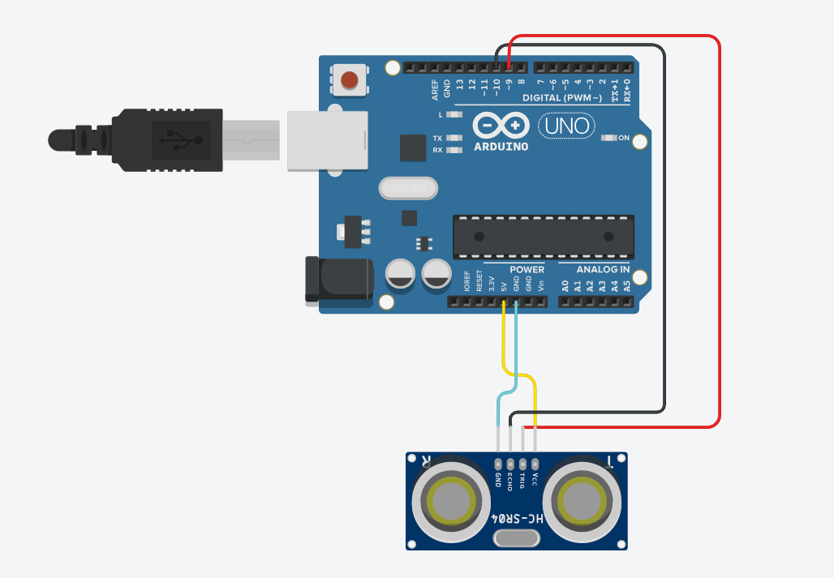
SET-UP

Slide 6
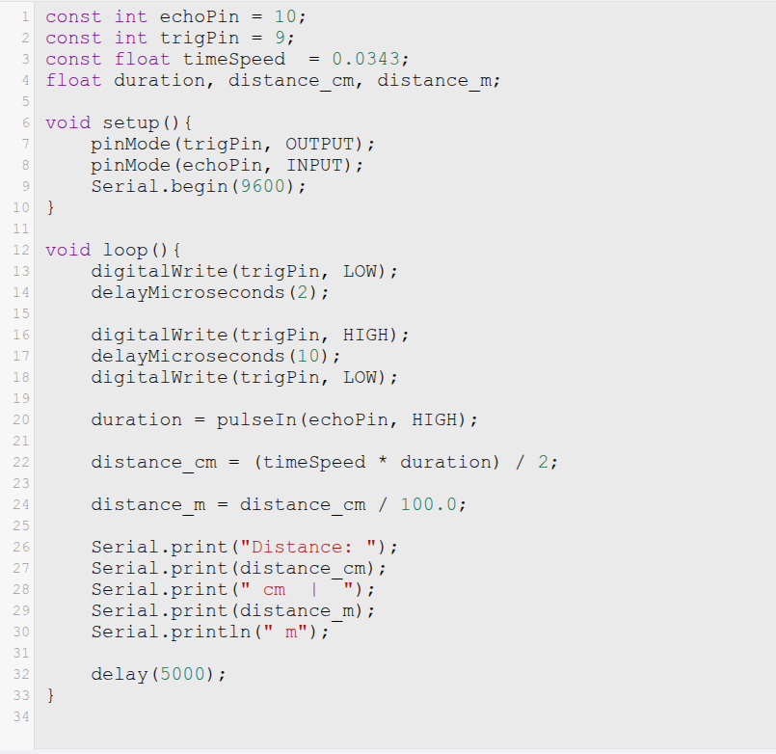
CODE

Slide 7
Output Demonstration
Output Demonstration
  Sensor sends pulse continuously
  Distance displayed on Serial Monitor or LCD
  Value changes as object moves closer or farther

Slide 8
Real Life Applications
Obstacle avoiding robots
Parking assistance systems
Smart distance measuring tools
Water level monitoring
Security and automation systems

